Slide 1
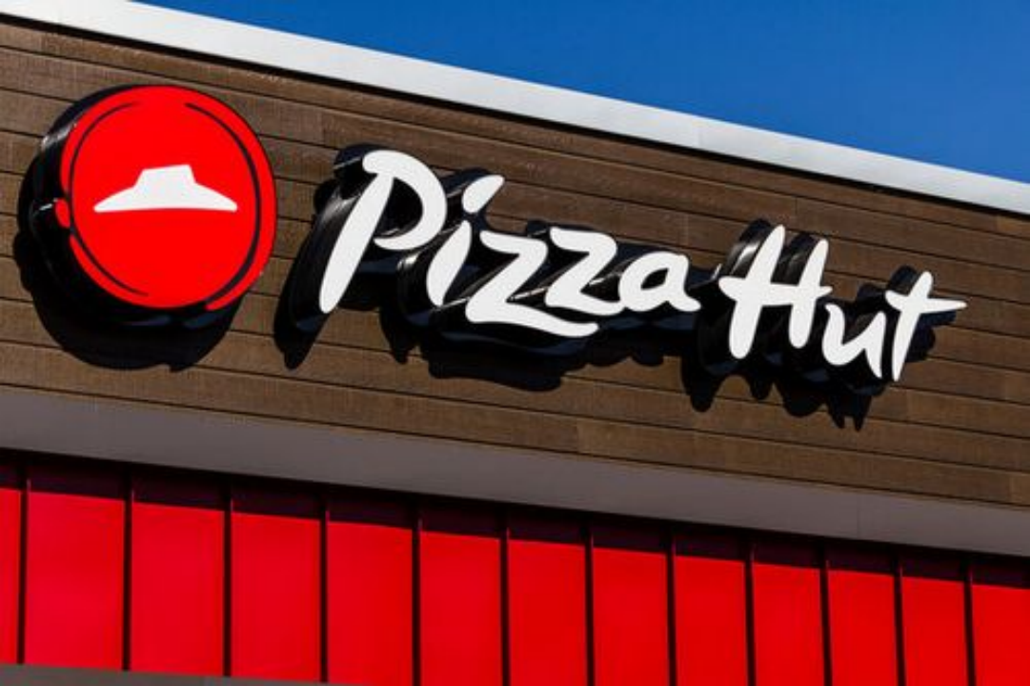





Pizza Hut Data Analysis
Hello Connections!
PRESENTED BY: VIBHU SHARMA ✌️
LINK: HTTPS://GITHUB.COM/VIBHUSHARMA2/PIZZA-HUT-ANALYSIS-USING-MYSQL

Slide 2



About the Project:
This project focuses on analyzing Pizza Hut's operational data using MySQL to gain insights into customer preferences, revenue generation, and order distribution.
Problem Statement:
RETRIEVE THE TOTAL NUMBER OF ORDERS PLACED.
CALCULATE THE TOTAL REVENUE GENERATED FROM PIZZA SALES.
IDENTIFY THE HIGHEST-PRICED PIZZA.
IDENTIFY THE MOST COMMON PIZZA SIZE ORDERED.
LIST THE TOP 5 MOST ORDERED PIZZA TYPES AND THEIR QUANTITIES.
JOIN TABLES TO FIND THE TOTAL QUANTITY OF EACH PIZZA CATEGORY ORDERED.
DETERMINE ORDER DISTRIBUTION BY HOUR OF THE DAY.
FIND CATEGORY-WISE DISTRIBUTION OF PIZZAS.
GROUP ORDERS BY DATE AND CALCULATE THE AVERAGE NUMBER OF PIZZAS ORDERED PER DAY.
DETERMINE TOP 3 MOST ORDERED PIZZA TYPES BASED ON REVENUE.
CALCULATE THE PERCENTAGE CONTRIBUTION OF EACH PIZZA TYPE TO TOTAL REVENUE.
ANALYZE CUMULATIVE REVENUE GENERATED OVER TIME.
DETERMINE TOP 3 MOST ORDERED PIZZA TYPES BY REVENUE FOR EACH PIZZA CATEGORY.

Slide 3

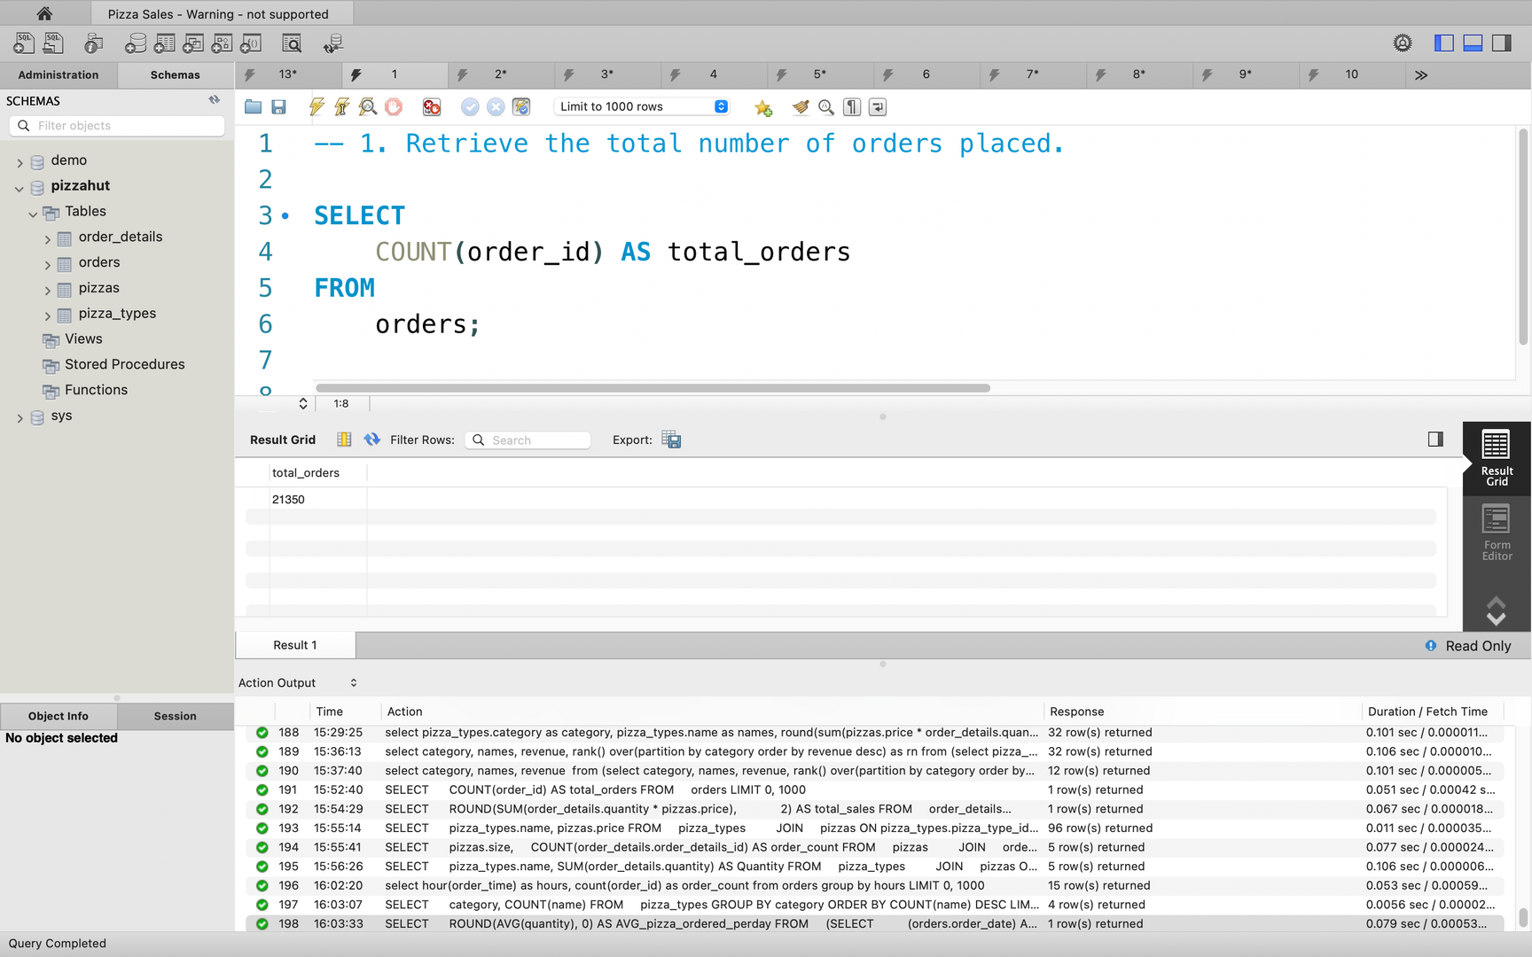
Problem 1 - Total Number of Orders
Statement: Retrieve the total number of orders placed.

Slide 4
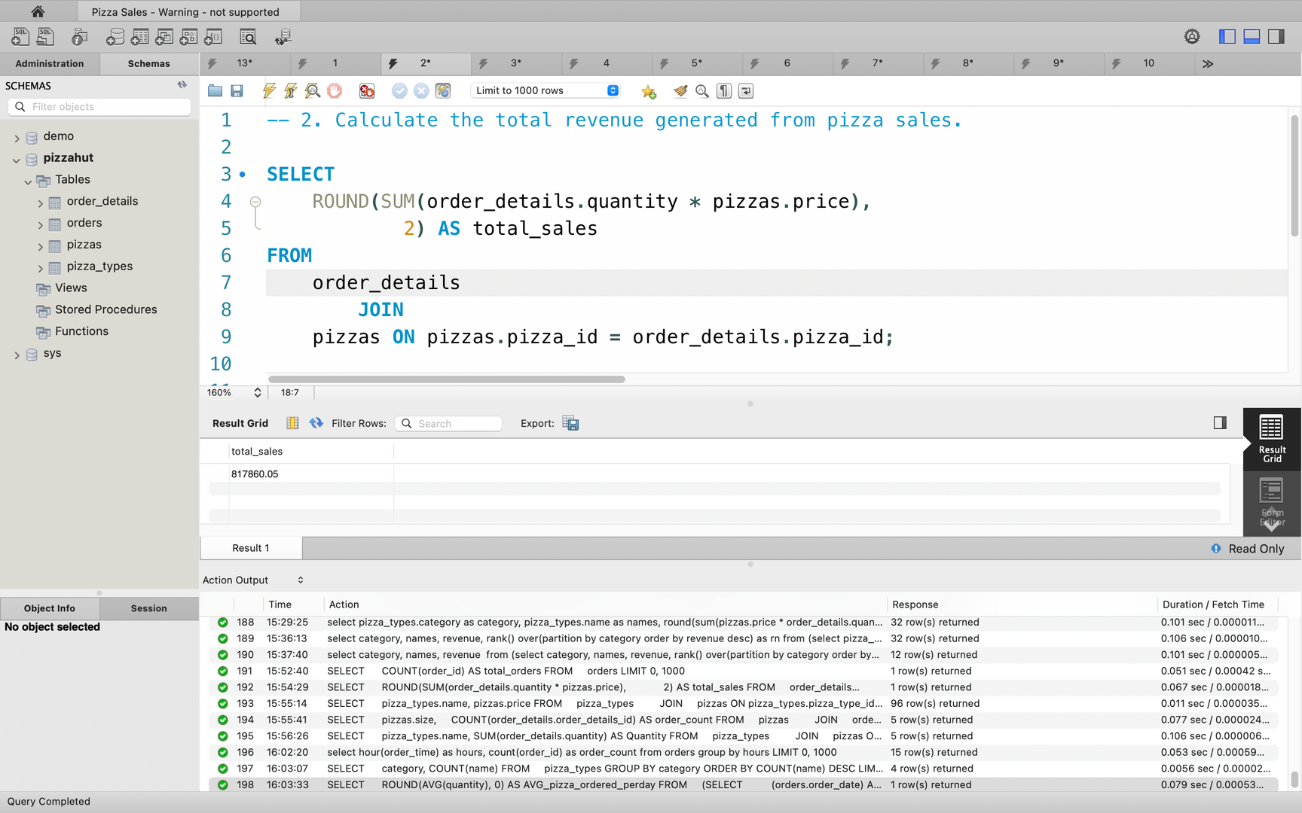
Problem 2 - Total Revenue
Statement: Calculate the total revenue generated from pizza sales.

Slide 5
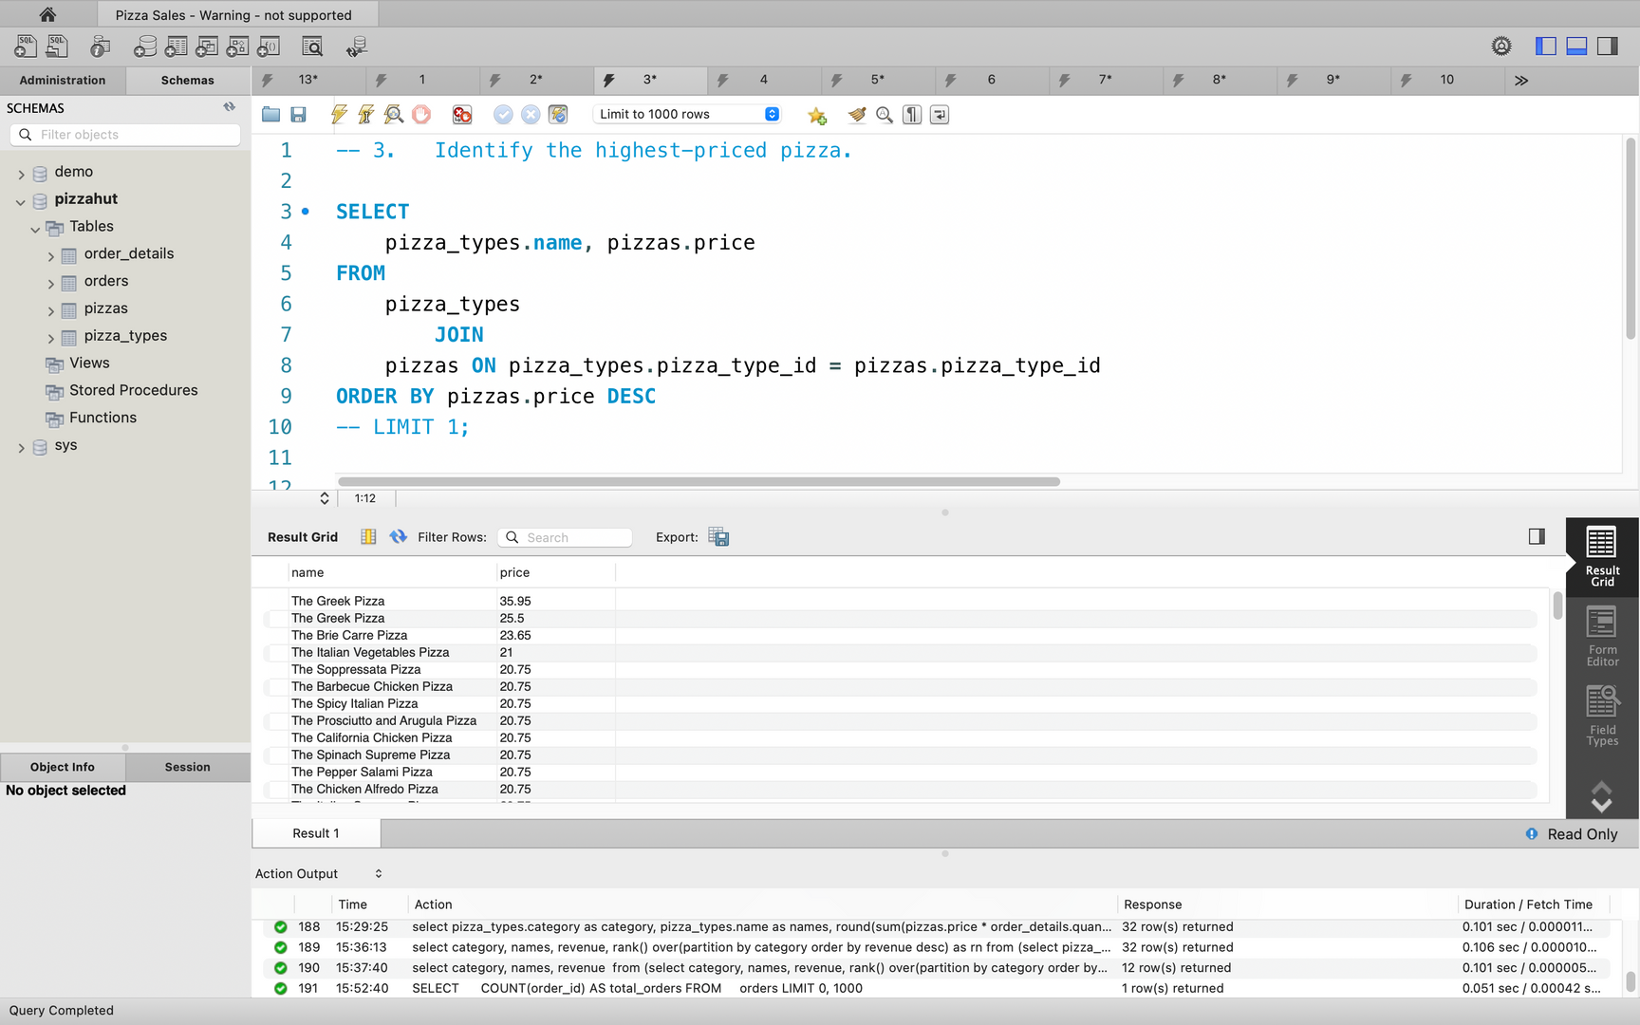
Problem 3 - Highest-Priced Pizza
Statement: Identify the highest-priced pizza.

Slide 6
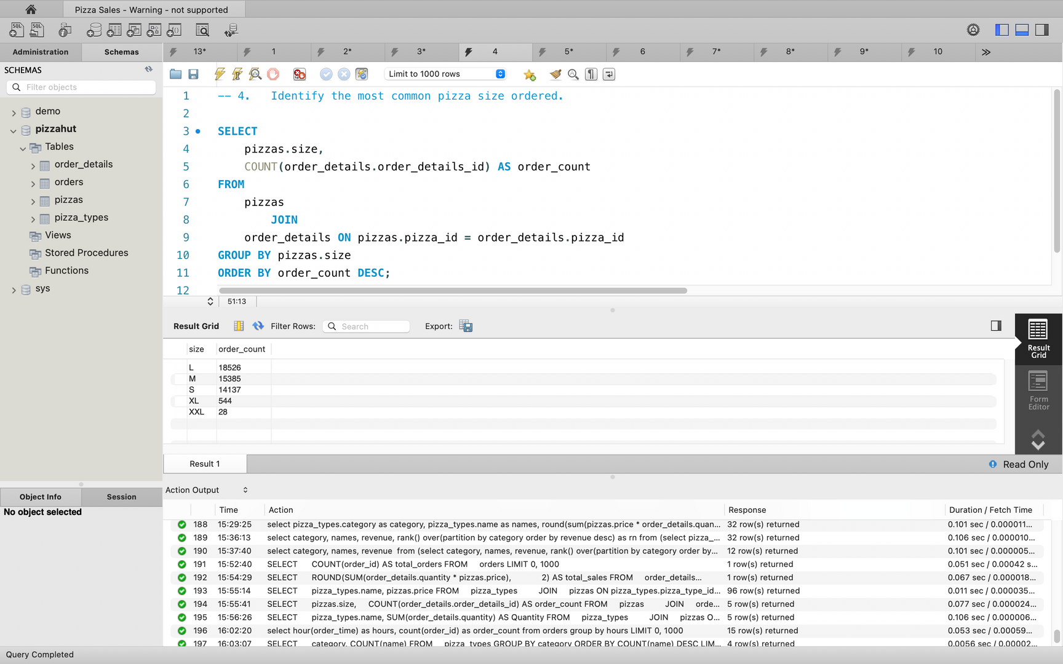
Problem 4 - Most Common Pizza Size
Statement: Identify the most common pizza size ordered.

Slide 7
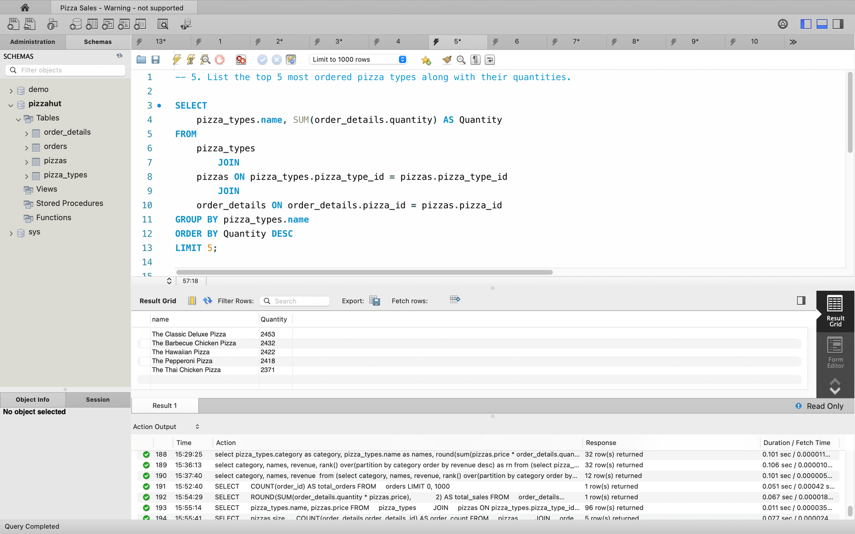
Problem 5 - Top 5 Ordered Pizza Types
Statement: List the top 5 most ordered pizza types along with their quantities.

Slide 8
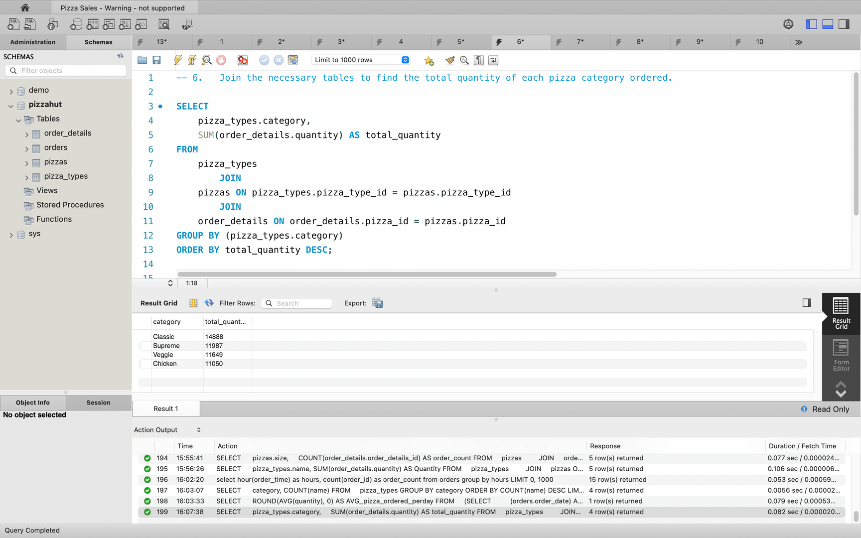
Problem 6 - Total Quantity of Pizza by Category
Statement: Find the total quantity of each pizza category ordered.

Slide 9
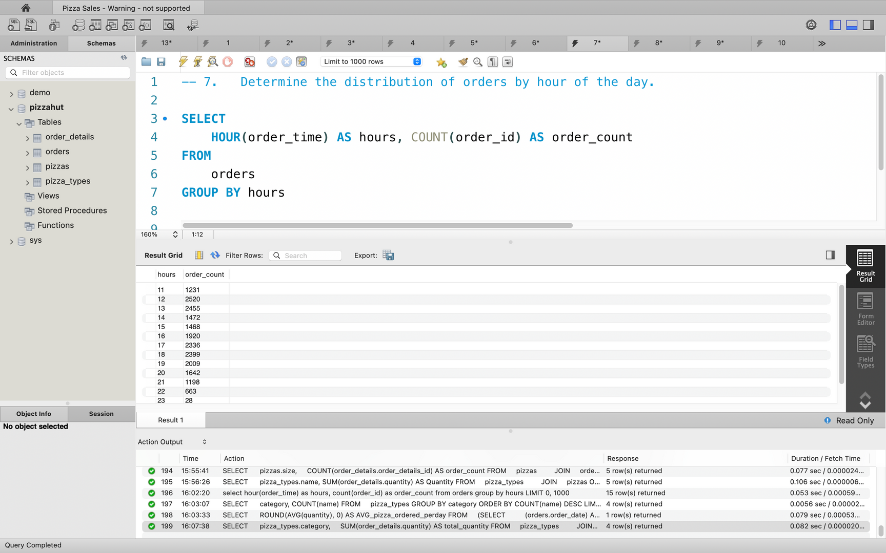
Problem 7 - Distribution of Orders by Hour
Statement: Determine the distribution of orders by hour of the day.

Slide 10
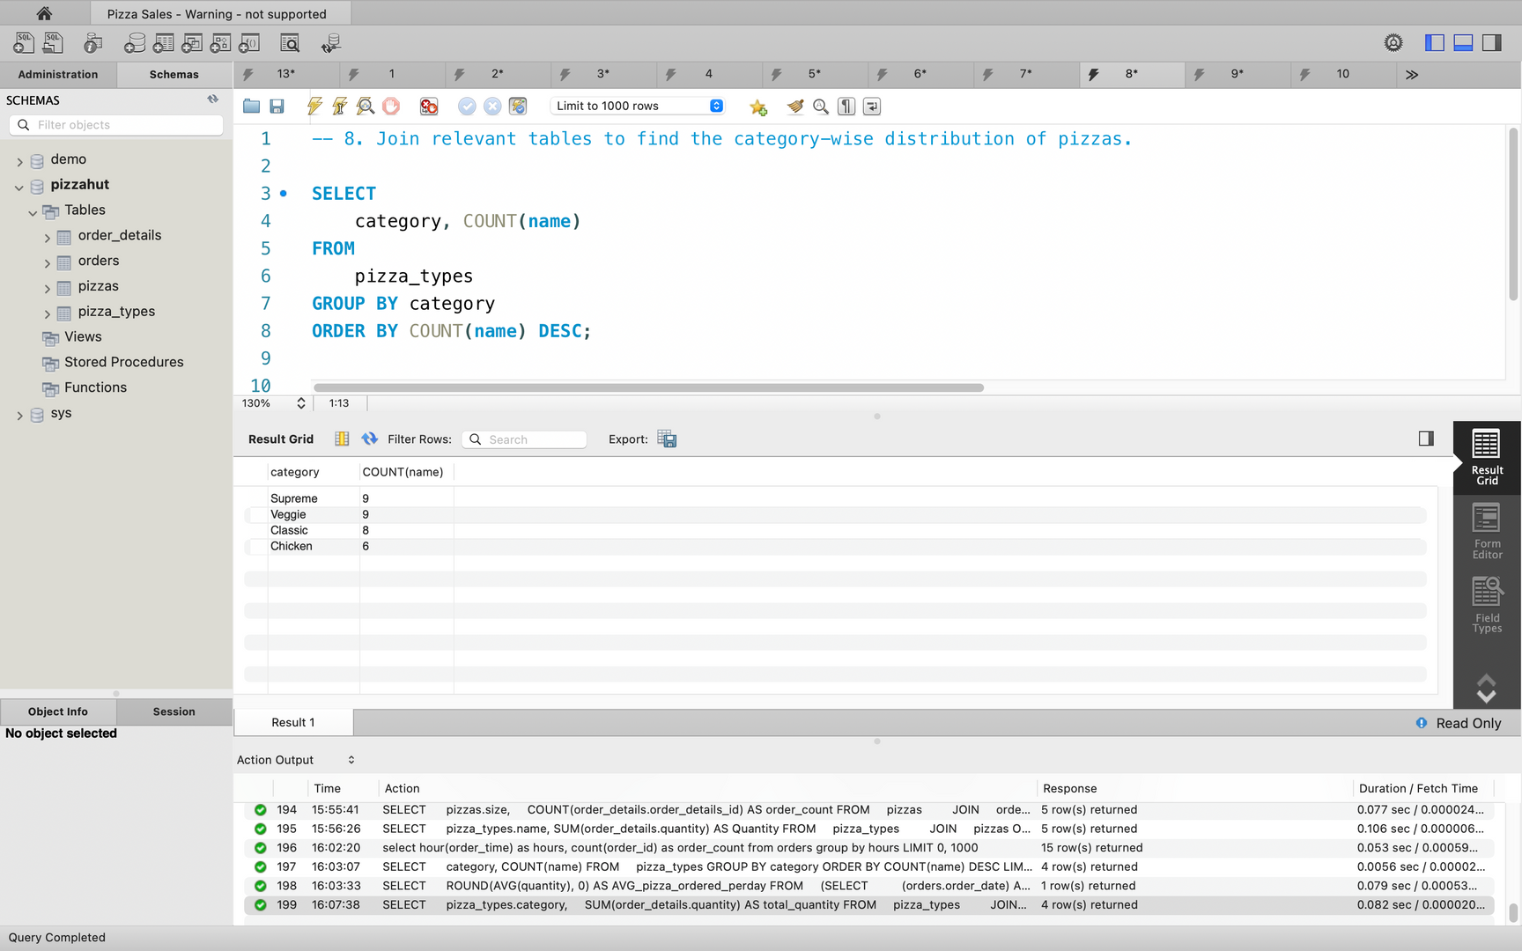
Problem 8 - Category-Wise Distribution of Pizzas
Statement: Join relevant tables to find the category-wise distribution of pizzas.

Slide 11
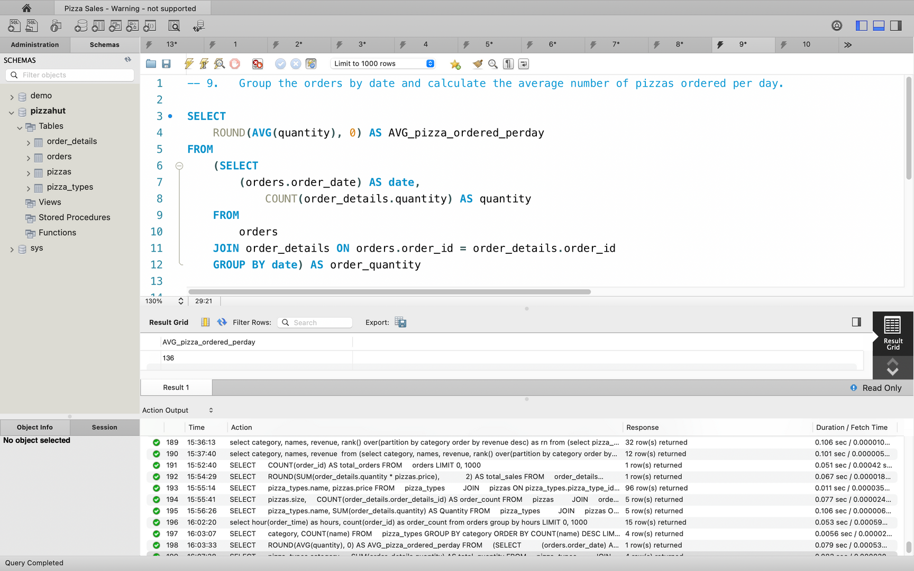
Problem 9 - Average Pizzas Ordered per Day
Statement: Group the orders by date and calculate the average number of pizzas ordered per day.

Slide 12
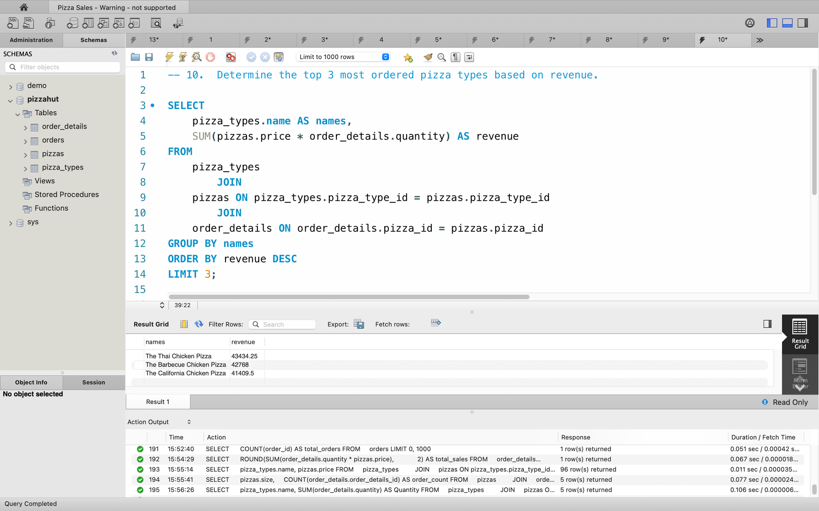
Problem 10 - Top 3 Most Ordered Pizza Types Based on Revenue
Statement: Determine the top 3 most ordered pizza types based on revenue.

Slide 13
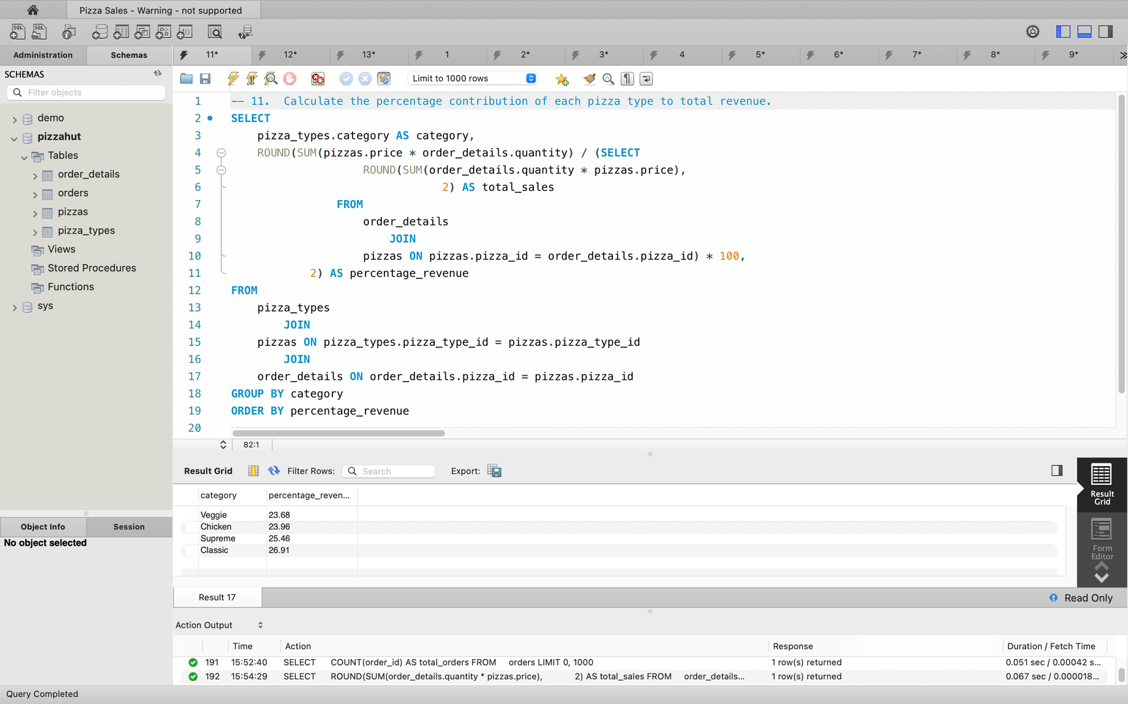
Problem 11 - Percentage Contribution to Total Revenue
Statement: Calculate the percentage contribution of each pizza type to total revenue.

Slide 14
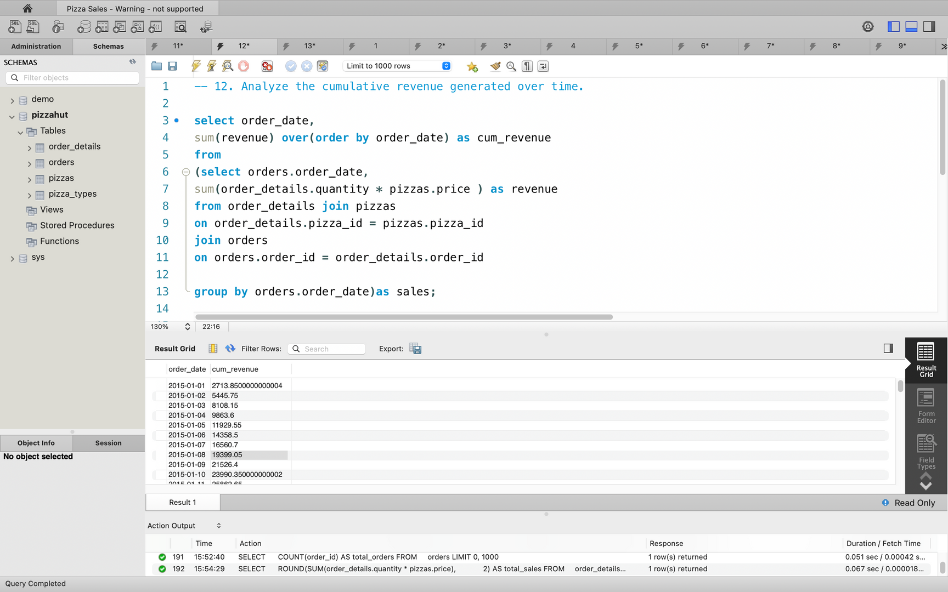
Problem 12 - Cumulative Revenue Over Time
Statement: Analyze the cumulative revenue generated over time.

Slide 15
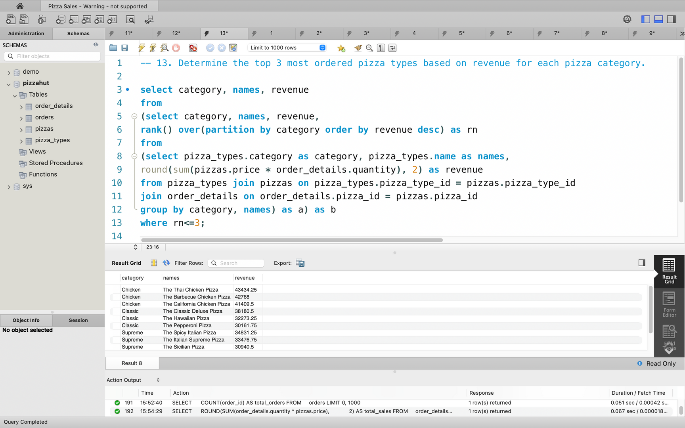
Problem 13 - Top 3 Most Ordered Pizza Types by Category Revenue
Statement: Determine the top 3 most ordered pizza types based on revenue for each pizza category.

Slide 16


Conclusion
Most Popular Pizza Types:
The analysis revealed that Pepperoni and Margherita pizzas were the most ordered items, indicating strong customer preference for classic flavors.
Revenue Distribution:
Larger-sized pizzas consistently generated more revenue, highlighting the profitability of offering various size options. Combo deals and premium toppings were also significant contributors to overall sales.
Customer Behavior Insights:
The majority of orders were placed during peak hours, particularly during lunch and dinner times (12 PM - 2 PM and 7 PM–9 PM). This suggests that Pizza Hut could optimize staffing and inventory management around these times.
Category-wise Trends:
Veg and Non-Veg pizza categories showed varied preferences based on regional customer choices, allowing the business to tailor offerings according to market demand.
Cumulative Revenue:
A steady increase in cumulative revenue over time suggests that customer retention is strong, and periodic promotions may have played a role in sustaining this growth.

Slide 17

Thank you very much for YOUR Time
Like
Share
Connect
Excited to continue exploring data analysis projects.

